Slide 1
Collaborative Analysis of Petabyte-Scale Scientific Data
Jordan Raddick
Johns Hopkins University

Slide 2

Motivation
Much of the scientific process is about data
collect, clean, archive, organize, analyze, publish, mirror, distribute, curate…
Jim Gray: “Often it turns out to be more efficient to move the questions than the data.”

Slide 3
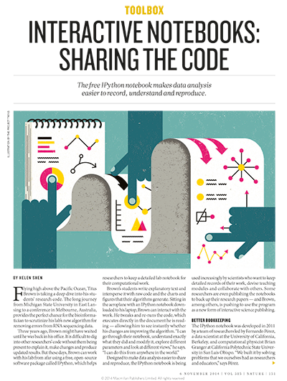
Motivation
Helen Shen: “Brown's students write explanatory text and intersperse it with raw code and the charts and figures... Sitting in the airplane… Brown can interact with the work..”
Nature, 5 November 2014

Slide 4
History
Started with the SDSS SkyServer (2001)
Goal: instant access to rich content
2012: NSF DIBBS to extend/reengineer SkyServer

Slide 5
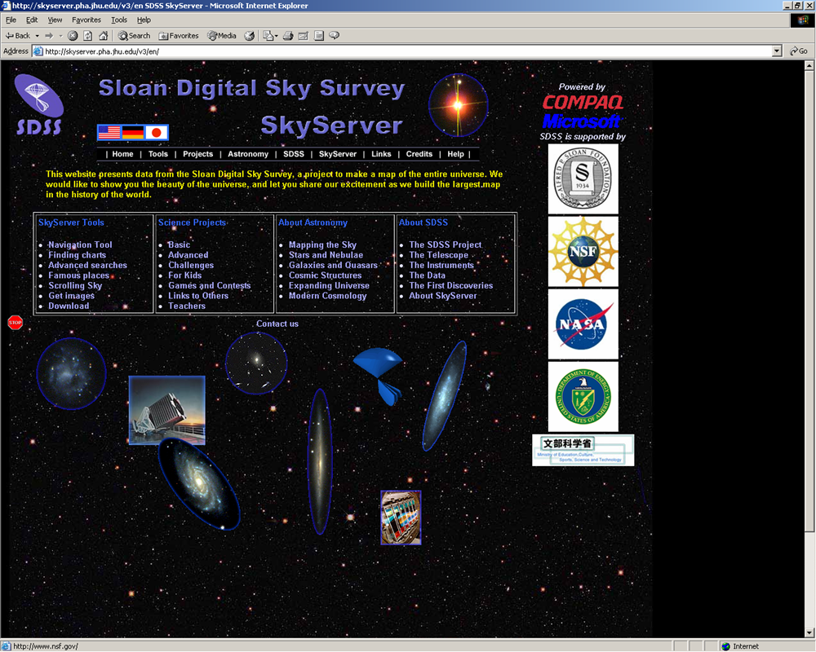
SkyServer in 2001

Slide 6
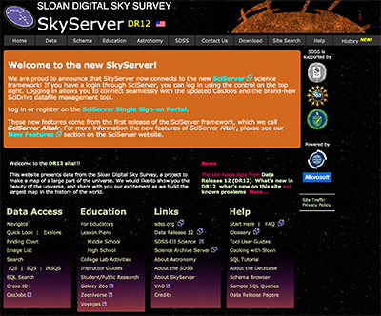
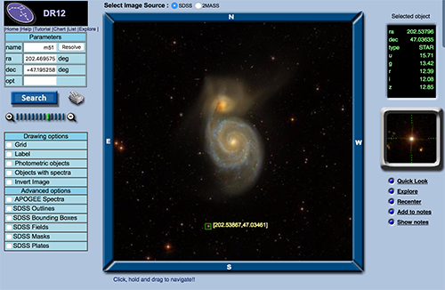
SkyServer today

Slide 7
Data from HPC Simulations
HPC is an instrument in its own right
Need public access to the best and latest
Largest simulations approach/exceed petabytes
Also need ensembles of simulations
Creates new challenges
Access?
Data lifecycle?
Analysis patterns?
Architectural support?
Our total science data: ~2.5PB
Everything is a Big Data problem!

Slide 8
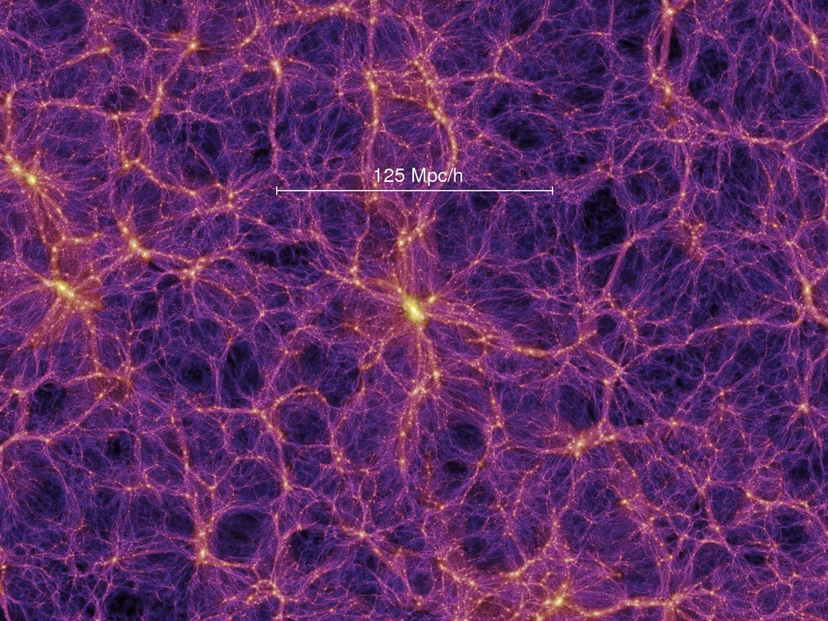

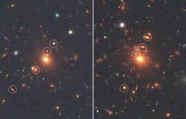
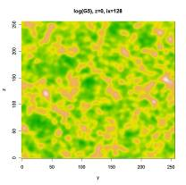
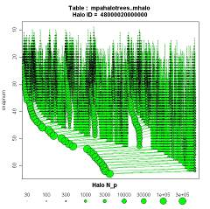
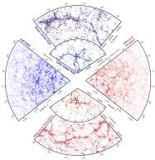
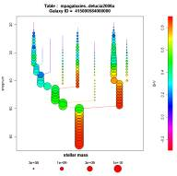
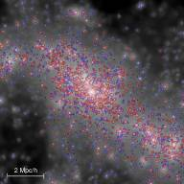
Cosmological Simulations
Mirror of Millennium DB (universe sim)
Raw data:
Particles
FOF groups
Subhalos
Mock images
Halo merger trees
Density fields
Synthetic galaxies
Mock catalogs

Slide 9
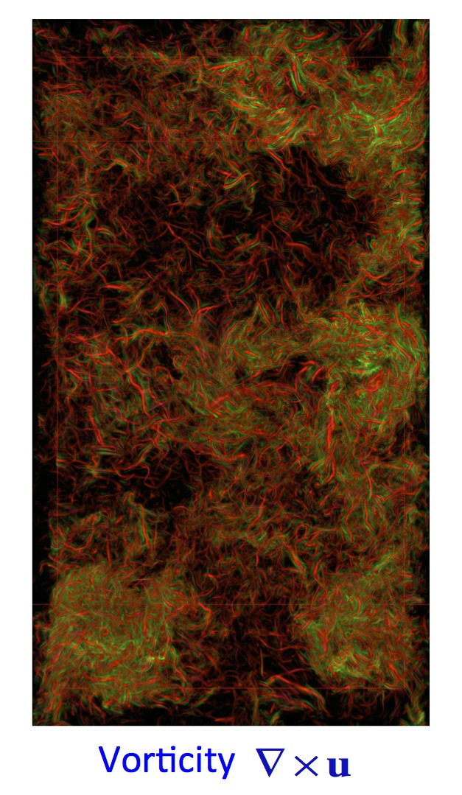
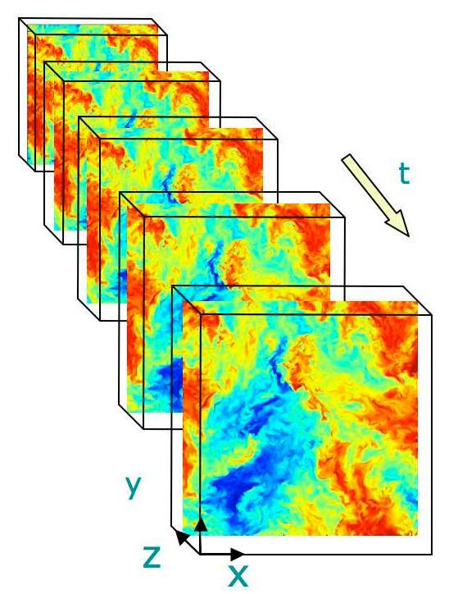
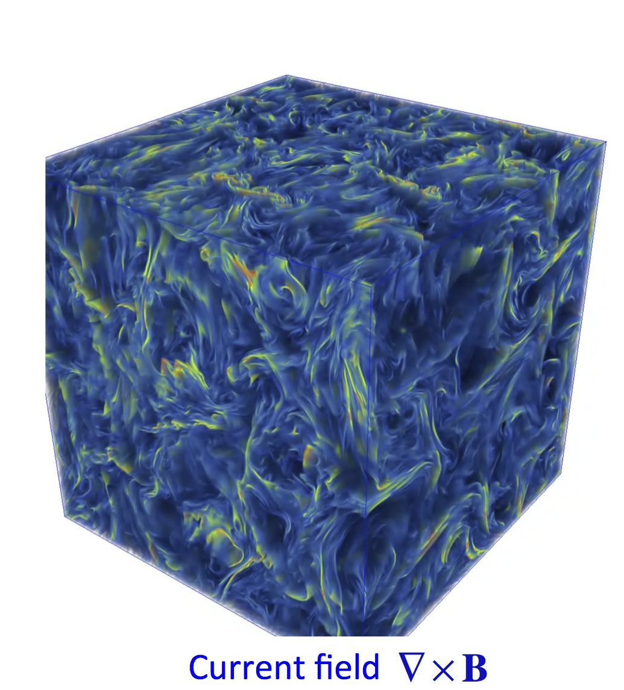
Turbulence databases (JHUTB)
http://turbulence.pha.jhu.edu/

Slide 10
Next step: Numerical Laboratories
From data retrieval to data analysis
No need to download entire datasets
Analysis is server-side through web services
Use virtual sensor metaphor (“the cow in the tornado”)
Many access patterns are local in space and/or time
turbulence.pha.jhu.edu: 19 trillion points delivered!

Slide 11
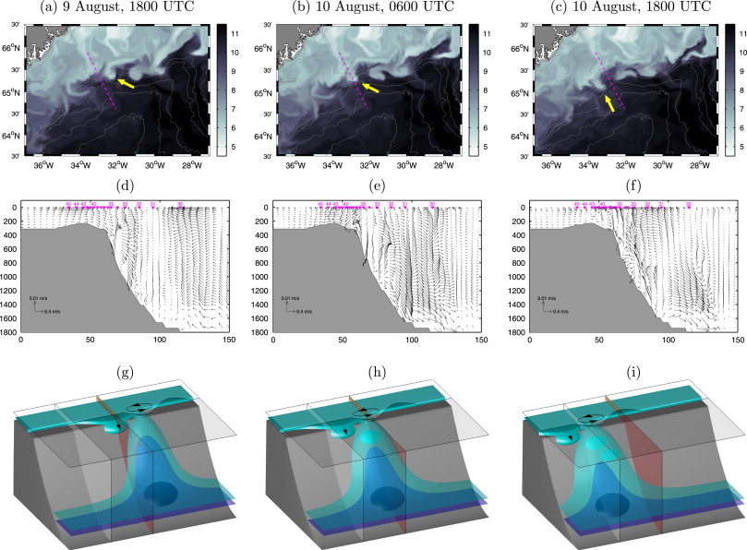
Oceanography
Hydrostatic and non-hydrostatic simulations of dense waters cascading off a shelf: The East Greenland case Marcello G. Magaldi, Thomas W.N. Haine

Slide 12
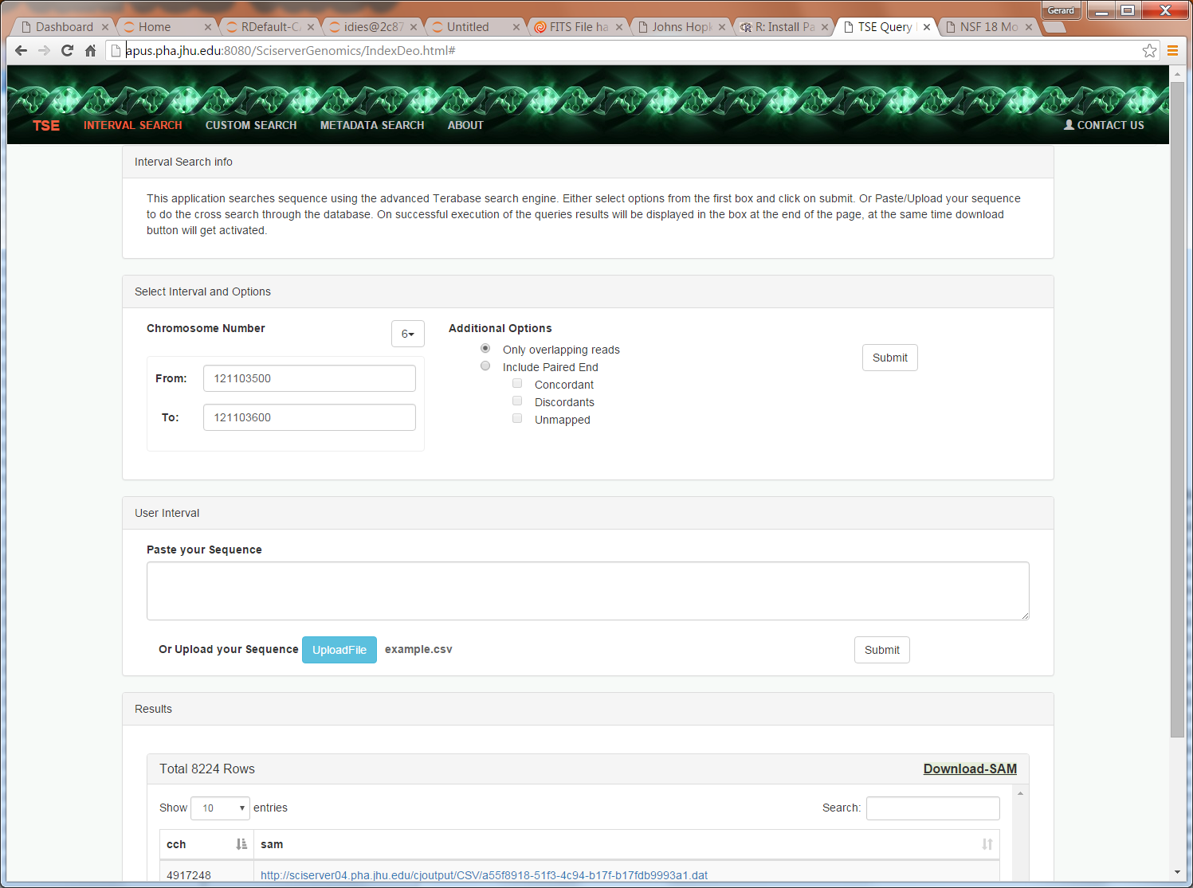
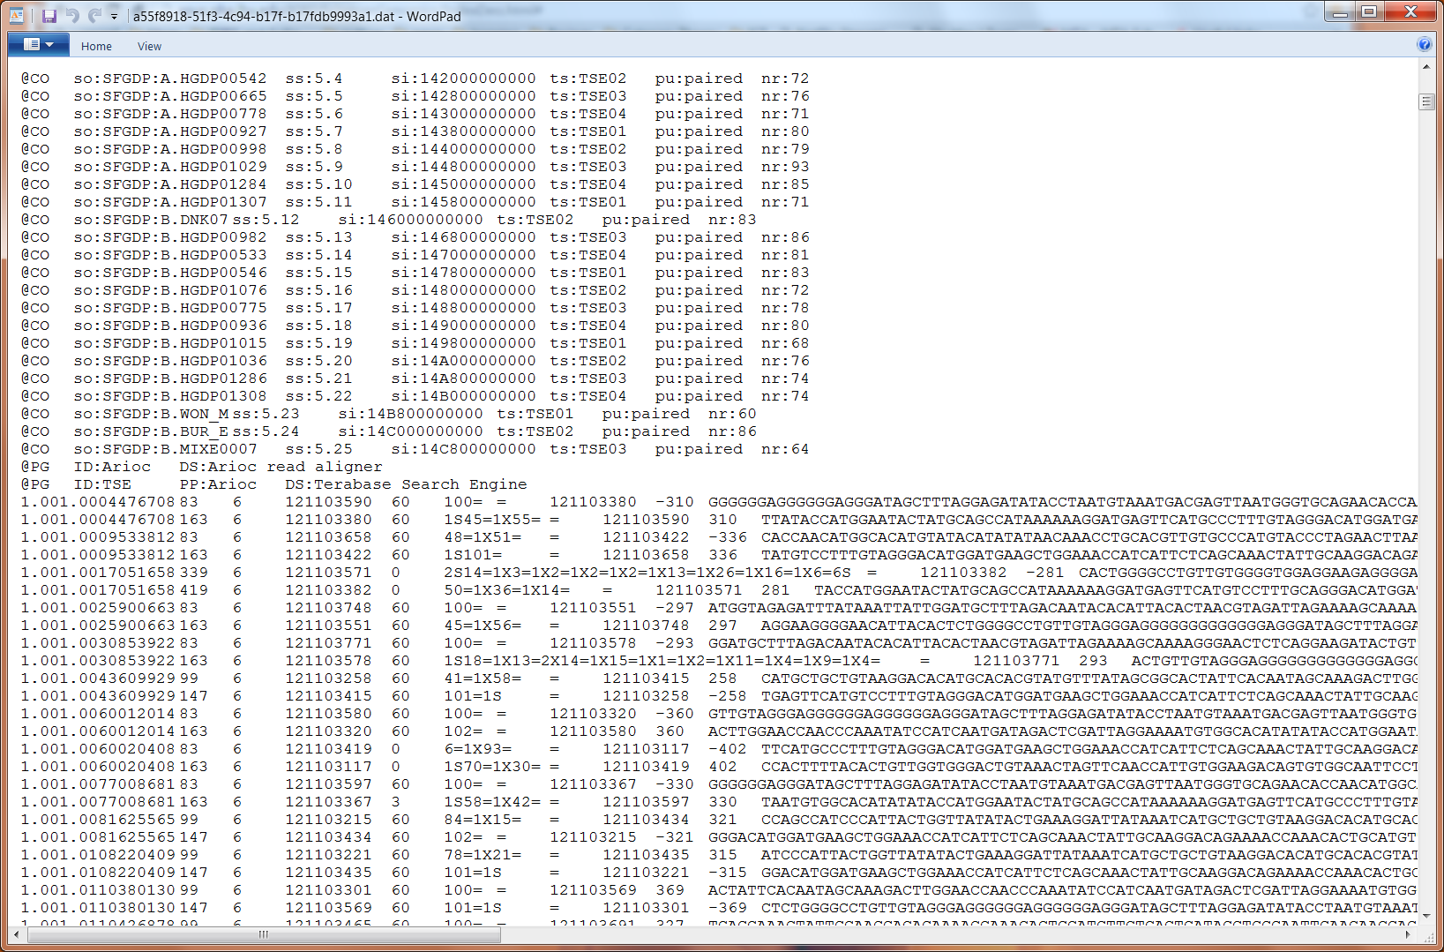
Genomics
Building a DB of a trillion short reads from Next Gen Sequencing

Slide 13
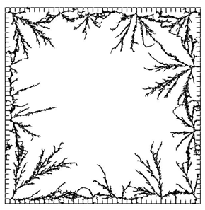
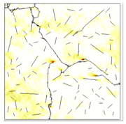
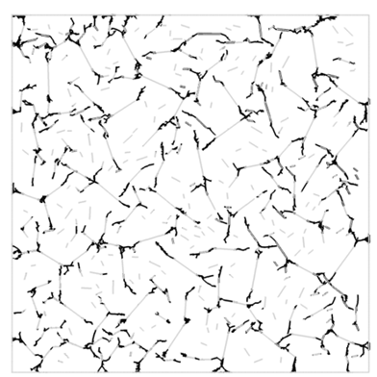
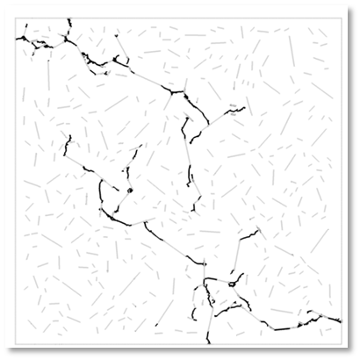
Materials Science
Daphalapurkar, Brady, Ramesh, Molinari. JMPS (2011)

Slide 14
SciServer Project Objectives
Extend infrastructure to support additional science domains
Host and serve Petabyte datasets
Support custom user datasets
Provide access and query services
Provide scalable compute services
Support analyses and data sets too large to handle locally
Provide collaborative tools for shared analysis
Computations stay CLOSE to the DATA…

Slide 15
SciServer Project Components
Major Components | Supporting Technologies
Core | Microsoft SQL Server
Login Portal | Open Stack
CASJobs | Docker
SciServer Compute | Jupyter
SciDrive
Applications
SkyQuery
SkyServer
GLUSEEN
Turbulence

Slide 16
SciServer Project Timeline
Timelines
Year 1 (2013-2014) | Project Setup, Scoping, Planning, Begin Refactoring, SDSS Unification
Year 2 (2013-2014) | Architectural Refactoring – API, Single Sign-on, prototype Compute
Year 3 (2013-2014) | SciServer System Release, Interactive Compute, Scalable Job Management, Basic Dashboard, Initial Collaborative capabilities
Year 4 (2013-2014) | Implementation in Science Domains, Educational workbooks
Year 5 (2013-2014) | System Scale out, Data Analytics, Advanced Deployment Scenarios
NOW

Slide 17
SciServer Project Current Plans
Timelines – Year 3
Apr 2016 | SciServer System Release
May 2016 | Interactive Compute SkyQuery Gluseen
August 2016 | Prototype Scalable Job Management Basic Dashboard Initial Collaborative capabilities
October 2016 | Scalable Job Management Turbulence Cosmology
November 2016 | Project 3 year Review

Slide 18
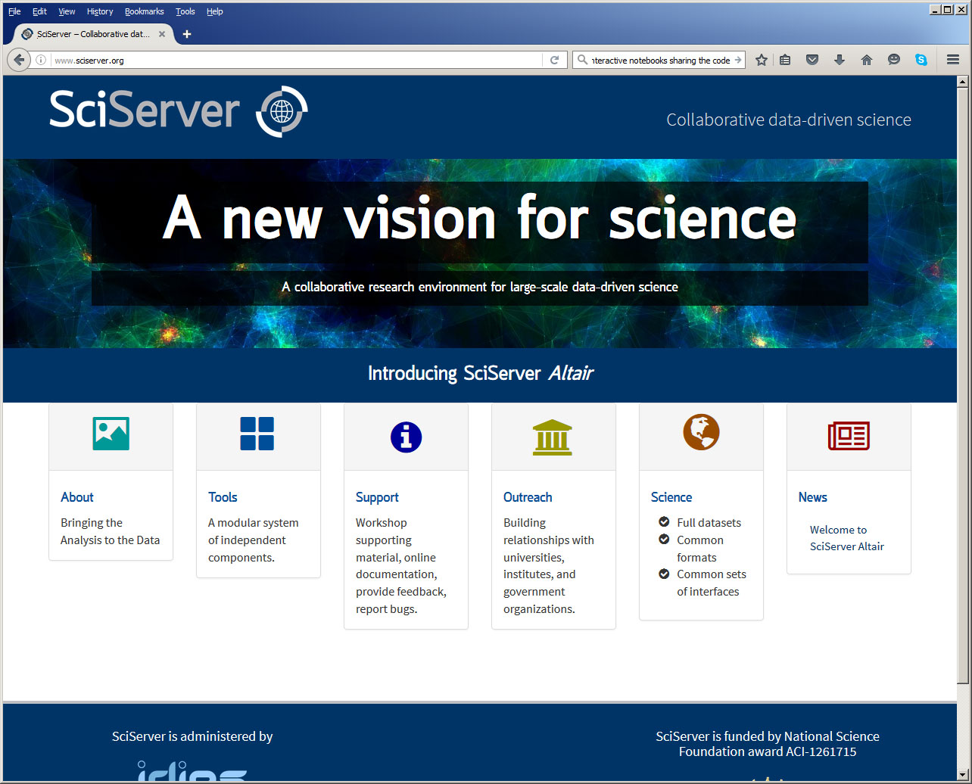
Login Portal

Slide 19
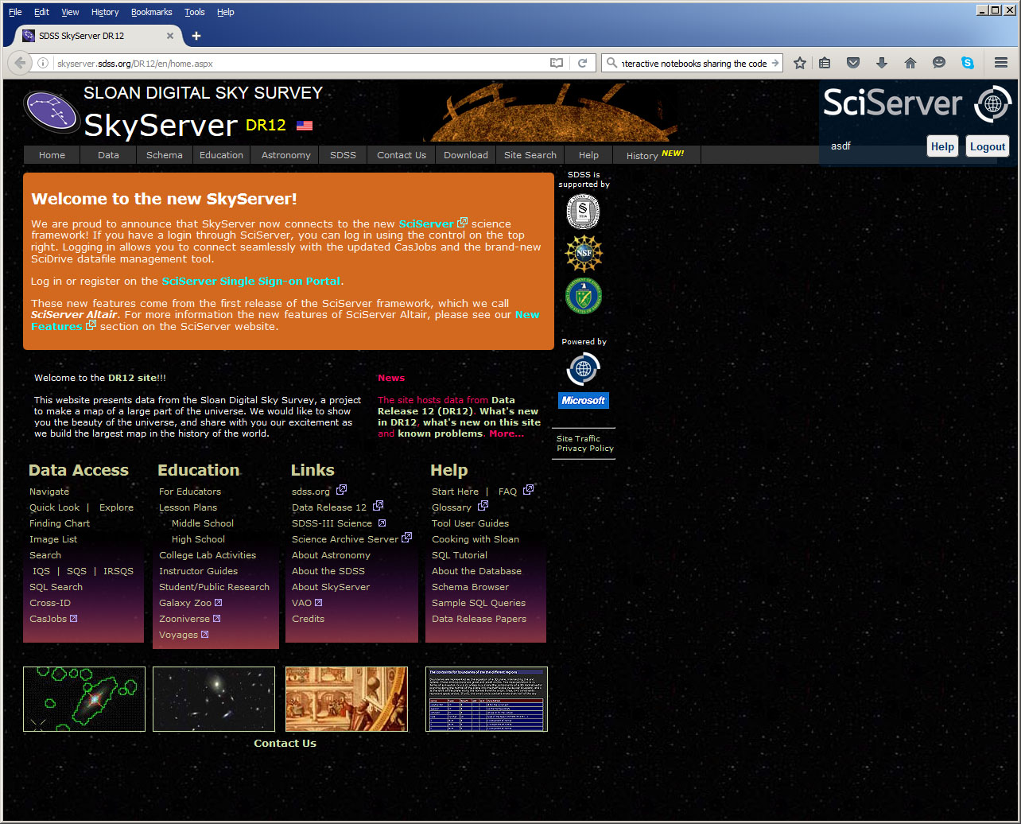
SkyServer

Slide 20
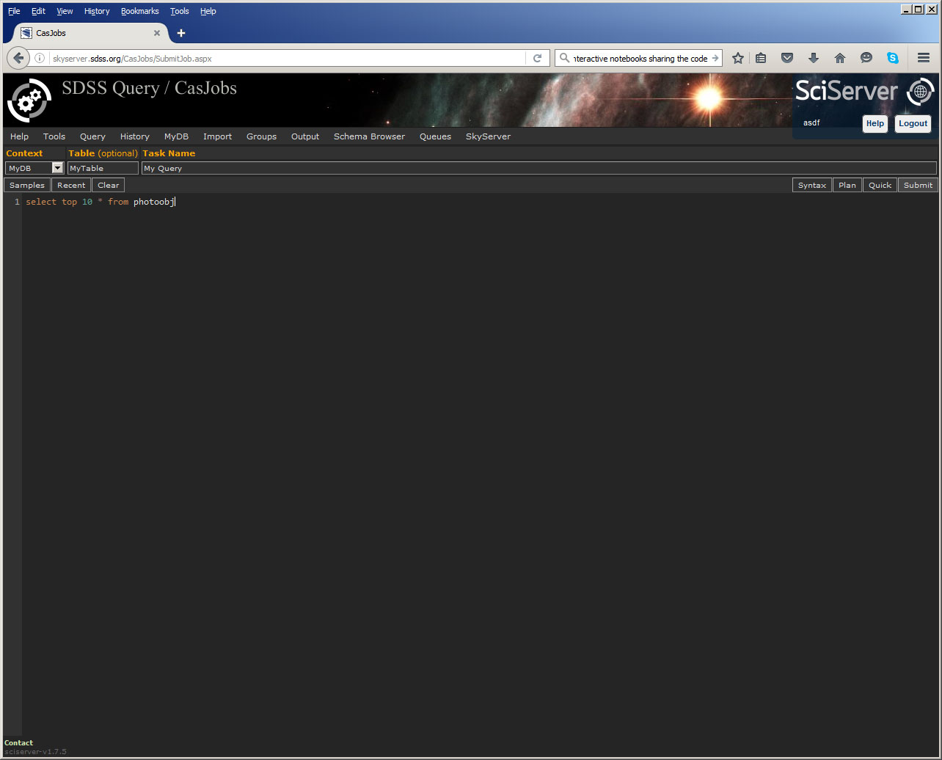
CasJobs: Query

Slide 21
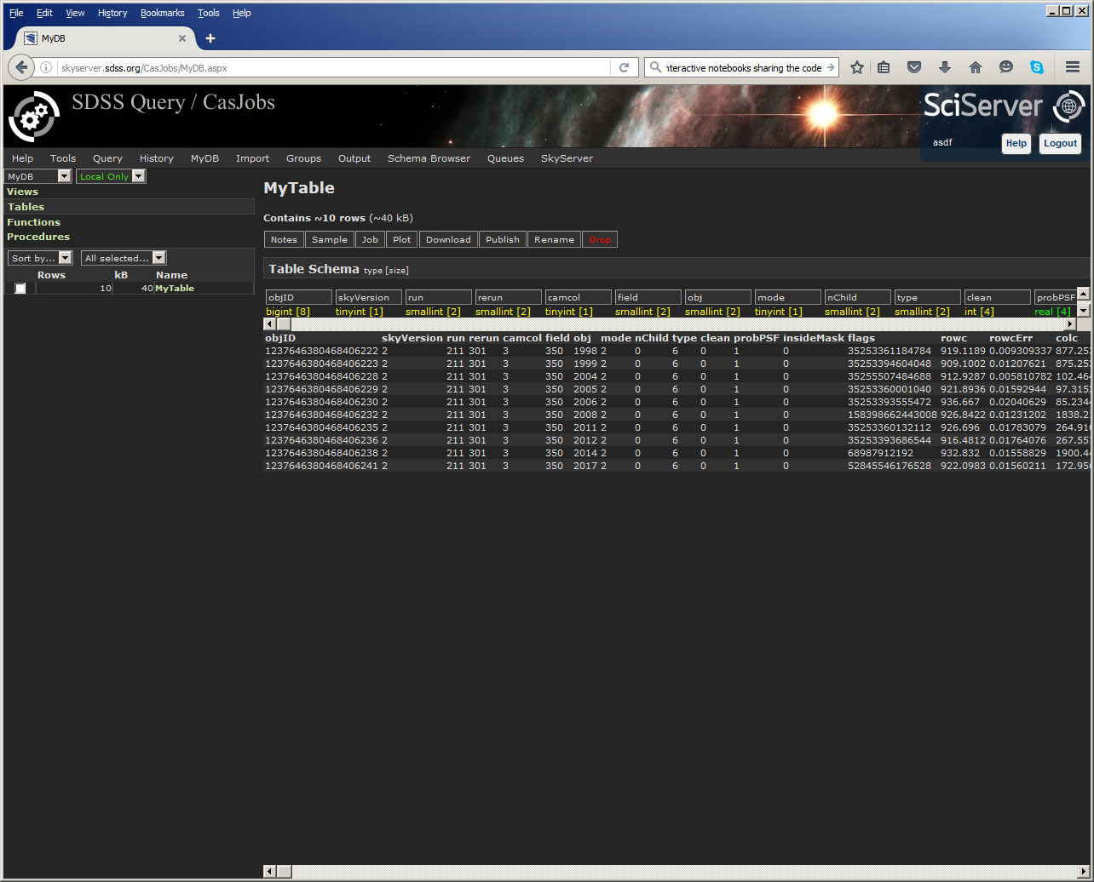
CasJobs: MyDB

Slide 22
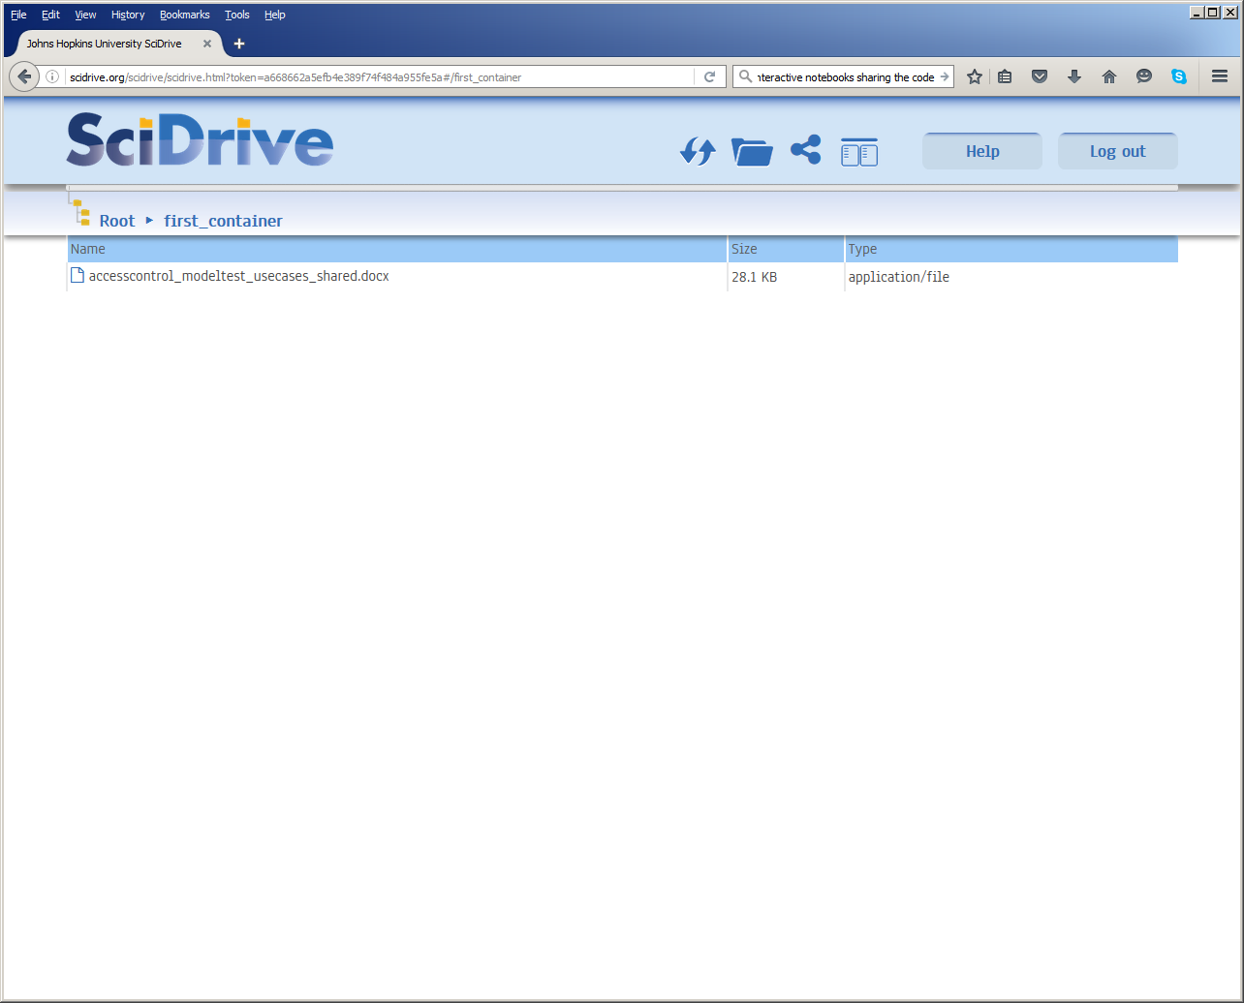
SciDrive

Slide 23
What is SciServer Compute?
Interactive Jupyter notebooks hosted inside Docker containers.
Pre-configured images to create new containers from (R, Python, MATLAB, …).
High-bandwidth, low-latency access to other SciServer services and data sources through the notebooks.
Users manage their own containers.

Slide 24
What are Docker Containers?

Slide 26
Data Storage Configuration

Slide 27
SkyServer Compute Status
Run asynchronous non-interactive jobs in separate Docker containers. It’s meant to be more than just Jupyter notebooks!
Create new VM nodes on-demand to accommodate growing number of users.
Provide scratch (temporary) storage space for working with large amounts of data.
Improve resource management.

Slide 28
Questions?

Slide 29
Architectural Challenges
Define tradeoffs
Data Analytics system is different from supercomputer
What is the right balance between I/O and compute?
Need high bandwidth to big data
Computations/visualizations must be on top of the data
Must support at least few 100TB per server
Petascale: 3 copies for production (or erasure code?)
Wide area data movement/backbone is hard
Lessons from the database world:
It is nontrivial to schedule complex I/O patterns
For subsets we must use indexing, cache resilient storage

